Slide 1
MYLEGION: ONLINE MEMBERSHIP PROCESSING
Renew, transfer and add new members.
July 2024
Notes:
MyLegion allows administrators to process membership online to renew, transfer and add new members.

Slide 2
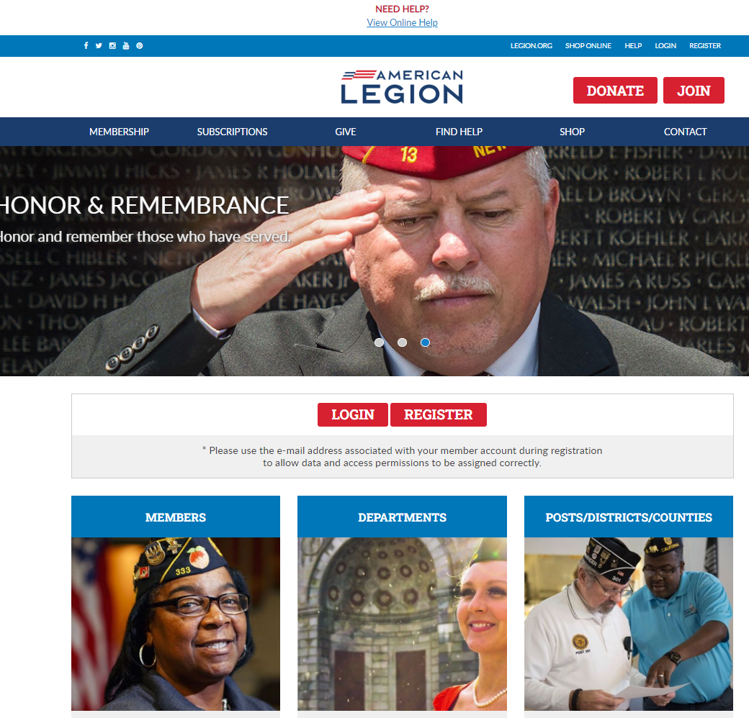
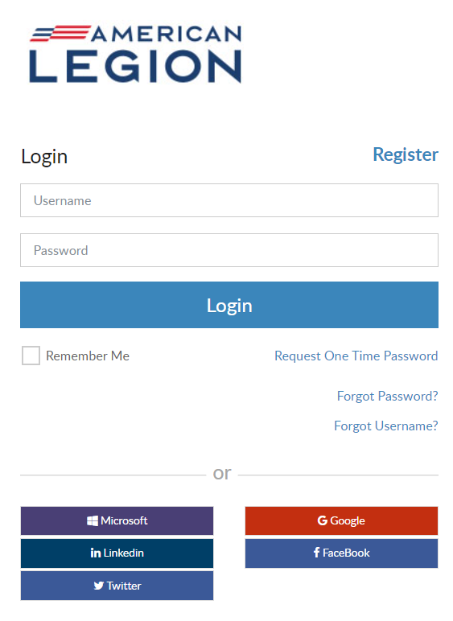
MYLEGION.ORG
Notes:
Log into MyLegion. All MyLegion accounts are registered to your individual member account using the primary email address on your record. Do not register a myLegion account with an email used by a group or another member.

Slide 3
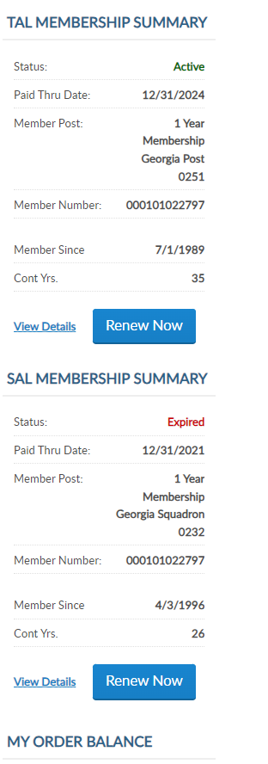
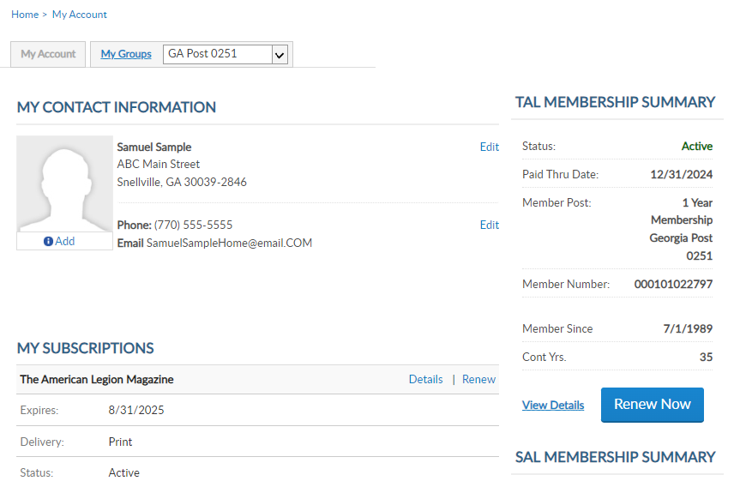
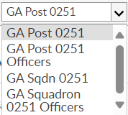
MYLEGION.ORG
My Account
Personal Member Info
My Groups
Adjutants & Commanders
Post, Squadron
District, County (View only)
Department, Detachment
Assigned Administrators
123456789
123456789
Notes:
When you log into MyLegion your My Account page displays information about your individual membership.
Adjutants and commanders of posts, squadrons, districts, counties, departments and detachments will have a My Groups menu when they are record in national’s membership system. The group menu is related to your position as an adjutant and commander. Members who have been assigned permission by one of the administrative officers will also have a My Groups menu. My groups is the administrative side of myLegion.
This member is a post adjutant and has 4 groups by default. <1> Legion leadership have access to both Legion and Sons of the American Legion groups. Officer groups are view only to see contact information for officers on file.
Clicking on the group will navigate you to the administrative side of MyLegion. To process membership, begin by going to the post or squadron group. In this example, we will select the post group.

Slide 4
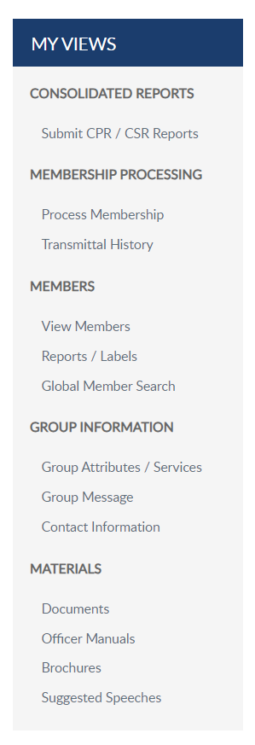
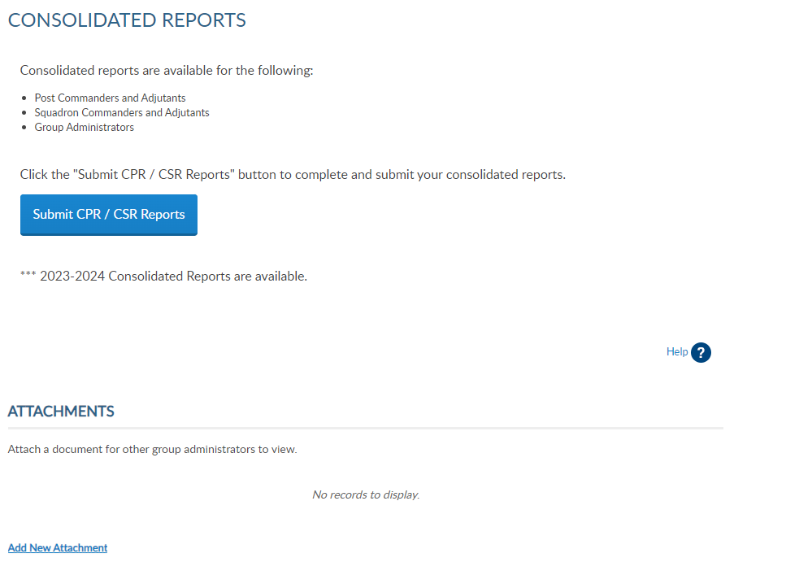
MEMBERSHIP PROCESSING
Process Membership
Renew
Add New Member
Transfer Renewing Mbr.
Transmittal History
Notes:
The group profile window includes a menu with administrative tools. Membership processing allows you to submit transmittals and view transmittal history. <1>
Create a transmittal by going to Process Membership. You can also access membership processing through View Members. Either option opens the Members window.
In this example, we will add and finalize a post transmittal. The post is selected in group menu, click Process Membership.

Slide 5
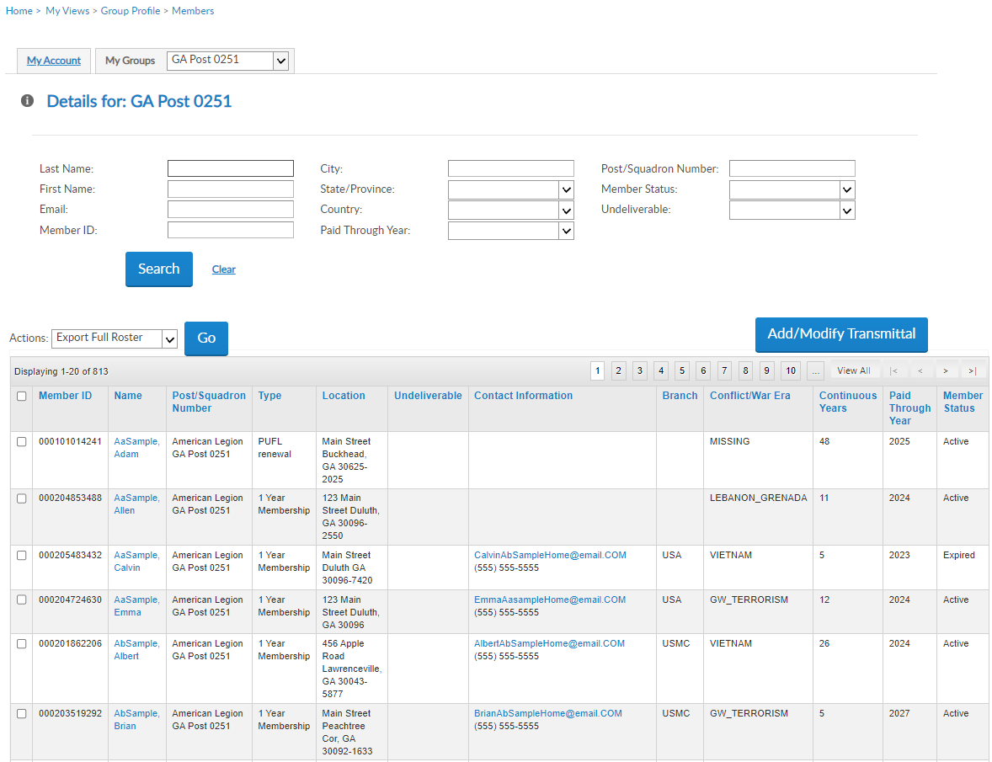
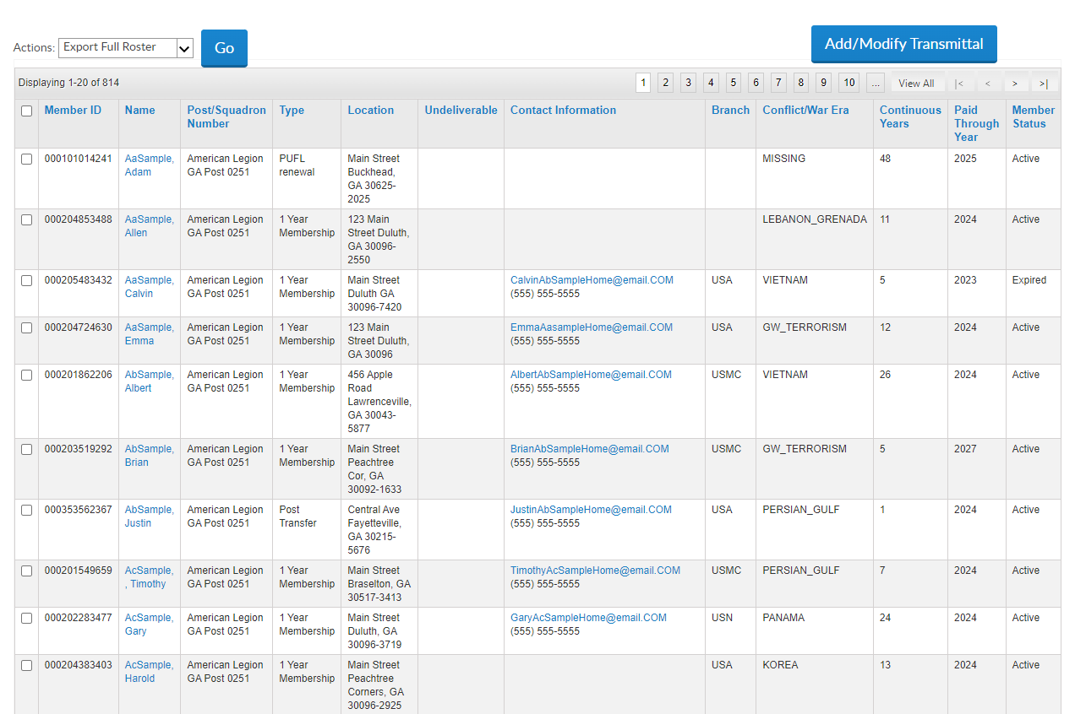
VIEW MEMBERS LIST
Group Profile > Members
View / Edit Mbrs
Paid Through Year
Add/Modify Transmittal
Post/Squadron
Department/Detachment
000123456781
000123456782
000123456783
000123456784
000123456781
000123456785
000123456782
000123456786
000123456783
000123456787
000123456784
000123456788
000123456785
000123456787
000123456786
000123456789
Notes:
The members window allows you to search and view members. The list includes all current, expired, future paid members, active and deceased.
This listing displays the Paid Through Year. Members paid for the current membership year or years greater than the current membership year, are not eligible for renewal and will not be in renewal list. Members with a LPY greater than the current membership year are members who have purchased multi-year renewal.
<2> Online membership processing is not available to district and county leadership and will not see the Add/Modify button. To begin a transmittal, click “Add/Modify Transmittal”.

Slide 6
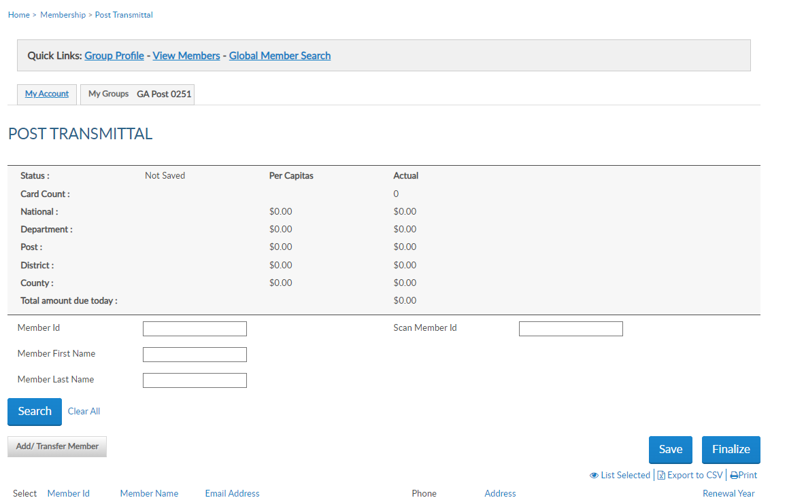
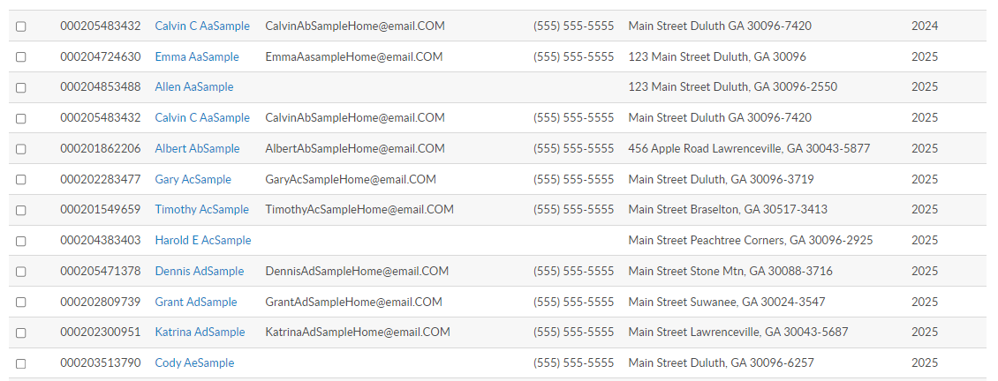
POST TRANSMITTAL
Transmittal Summary
Status
Card Count
Dues Allocations
Search
Member ID
Name
Renewal Year
Available Renewal Orders
000123456783
000123456784
000123456782
000123456783
000123456785
000123456787
000123456788
000123456789
000123456790
000123456791
000123456792
000123456793
Notes:
The post transmittal page open to begin adding members to the batch. The transmittal summary includes transmittal status, number of cards, and per capita allocations and total amount due. Total amount includes national and department only. These amounts do not display until a member is added to the batch, The summary area recalculates with each entry.
<1> Search options allow you to quickly search a member by ID or name.
<2> The renewal list is alphabetic and displays renewal orders that can be fulfilled.

Slide 7
RENEW MEMBERS
Search
Member ID
Name
Scan Member ID (current campaign mbrshp year )
000123456783
000123456784
000123456782
000123456783
000123456785
000123456787
000123456788
000123456789
000123456790
000123456791
000123456792
000123456793
Notes:
Renew members by searching for a renewal and checking the box.
<1> You can search a member by name or ID. The scan member ID field is for departments and large posts using bar code scanners. This allows you to scan the barcode from the membership card to auto enter in the field. However, you don't have to use a scanner to utilize the "Scan Member Id" box; you can just type the ID and hit enter and it will add the member to the transmittal. Using 'Scan Member Id' box applies the current campaign membership year and saves the record to the batch.

Slide 8
RENEW MEMBERS
Renewal List
Available Renewal Orders
Expired Member (current dues rates apply)
Back Dues (contact dept)
Not in the List?
Already paid
In a pending batch
Transferred out
Deeply exp, no renewal exists
000123456783
000123456784
000123456782
000123456783
000123456785
000123456787
000123456788
000123456789
000123456790
000123456791
000123456792
000123456793
Notes:
The renewal list is alphabetical and only displays members eligible for renewal. Members paid for the current membership campaign year will not display in this listing.
Expired members with more than one eligible renewal year will have a line for each one. <1> always note the renewal year column when adding to the batch. You can submit both years in the same batch. Current dues rates will be applied to past membership year payments.
<2> If you do not find the member to renew, the member is either already paid, in a pending transmittal, transferred out of your post, or expired for greater than 2 years. Tools available to determine the members status are located in Transmittal History, Current Roster, and Roster Updates.
Back dues can be processed through your department at the current dues rate.

Slide 9
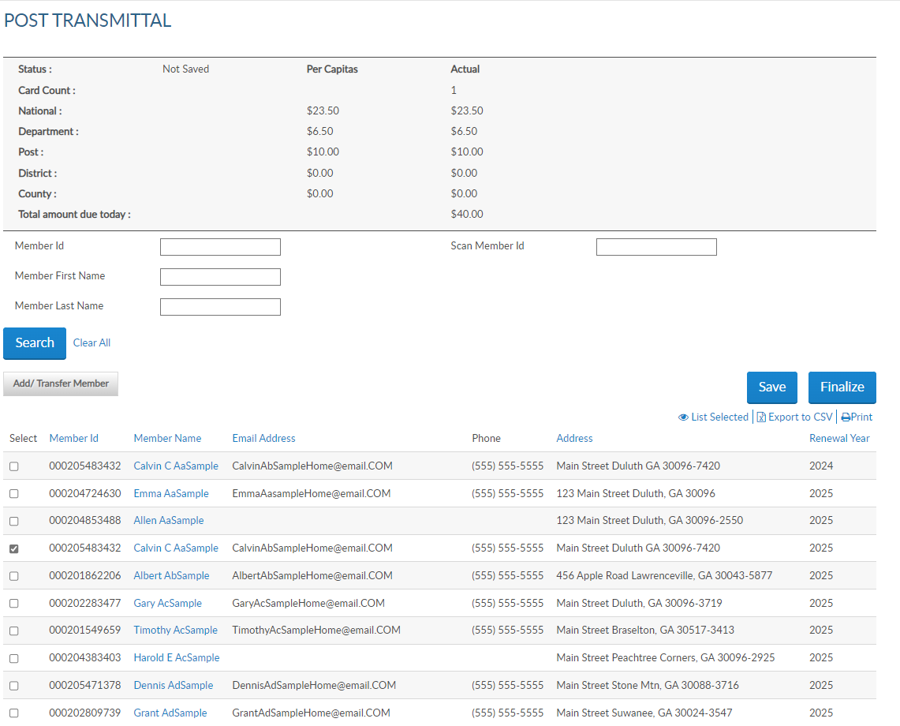
RENEW MEMBER
Check box to add to batch.
Batch Status
Not Saved
Open
Submitted
000123456783
000123456784
000123456782
000123456783
000123456785
000123456787
000123456788
000123456789
000123456790
000123456791
Notes:
To add a renewal, check the box next to the name for the correct renewal year. In this example I’ve checked a renewal for 2025. Even though he has a 2024 renewal available. Skipping a renewal year will reset his continuous year membership. At some point if he decides to pay for 2024, you can submit him as long as a renewal order exists. Because the renewals were not done in consecutive order, contact your department or go into his member record and adjust his continuous years.
The transmittal status is not saved. Click save and the status becomes open. <1> Exiting this area without saving the batch will result in re-entry. You will have 14 days to submit the open batch. If the open batch is not finalized within 14 days the batch is removed and all members will have to be re-entered. Reminder notifications are sent to post email address and the adjutant.
Continue renewing members by searching the member and checking the renewal year. Save each entry as you go if not using scan member ID. Using scan member ID automatically saves.

Slide 10
TRANSFER
Transfer Members
Renewing
Paid Mbrs – Submit MDF
Add/Transfer Member
000123456783
000123456784
000123456782
000123456783
000123456785
000123456787
000123456788
000123456789
000123456790
000123456791
Notes:
To transfer a renewing member, select Add/Transfer Member. <1> Only members that are renewing dues can be transferred online. To transfer paid members, complete a Member Data Form and send to your department.

Slide 11
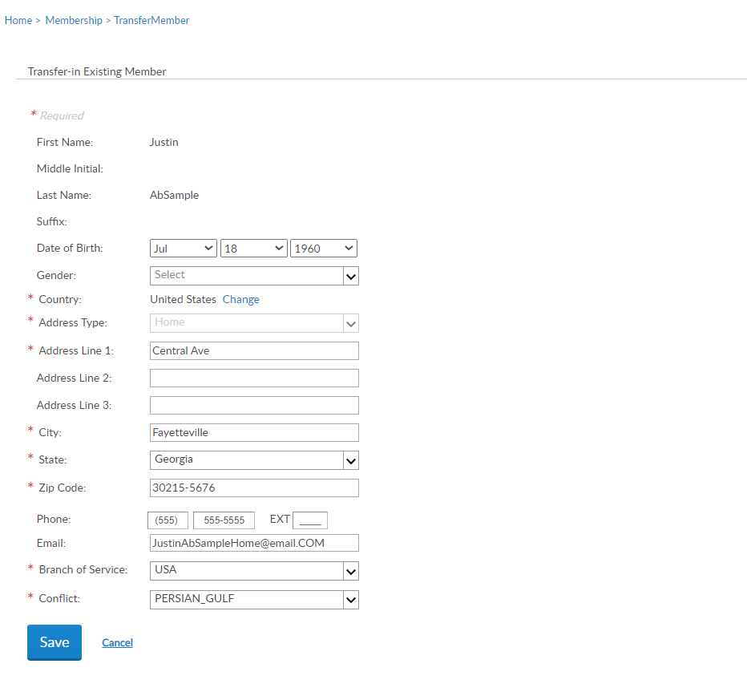
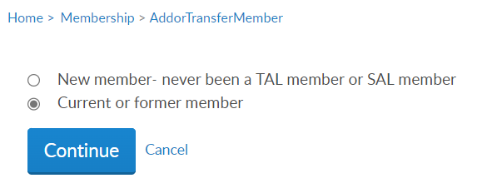
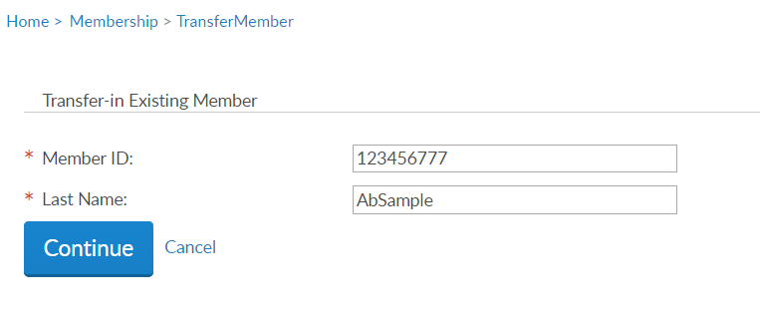
TRANSFER
Current or former member
ID# and Last Name
Update / Save
Notes:
Select current or former member and continue. <1> Enter the member ID# and last name and continue. <2>
Update any information needed and add any required data. Click Save to add the member to the batch.

Slide 12
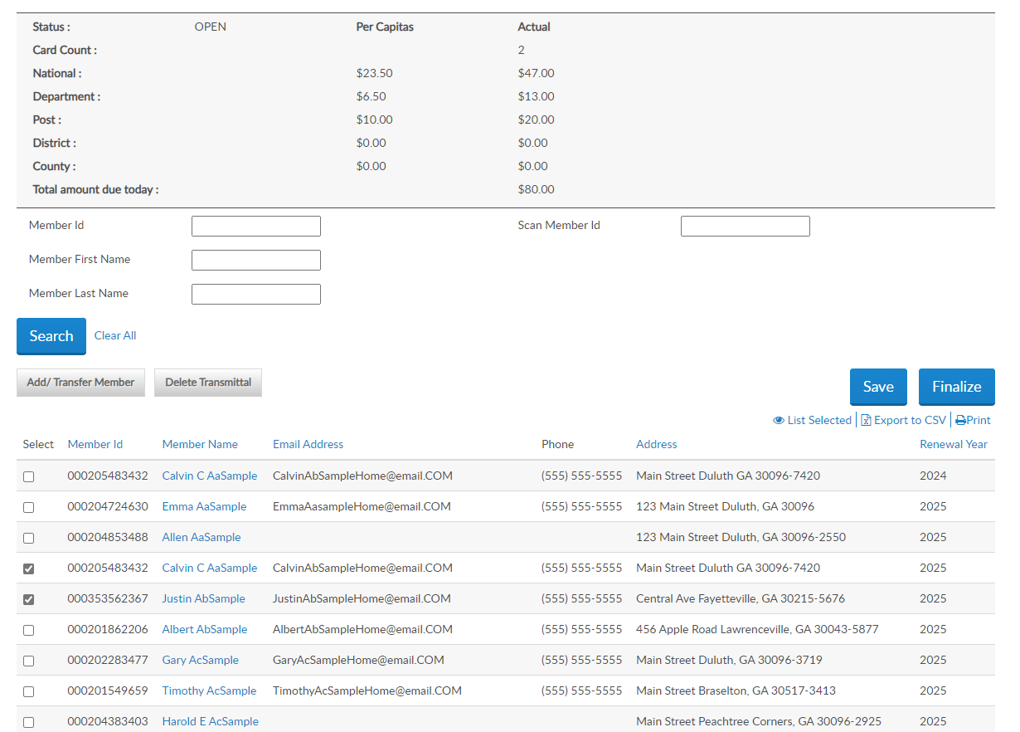
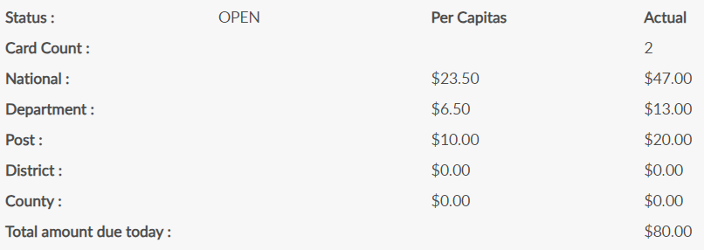
000123456783
000123456784
000123456782
000123456783
000123456777
000123456785
000123456787
000123456788
000123456789
Notes:
The Summary recalculates with the total amount due. The amount due equals department plus national per capita.

Slide 13
ADD NEW MEMBER
Add/Transfer Member
000123456783
000123456784
000123456782
000123456783
000123456777
000123456785
000123456787
000123456788
000123456789
Notes:
To add a new member or transfer a member select the Add/Transfer Member button.

Slide 14
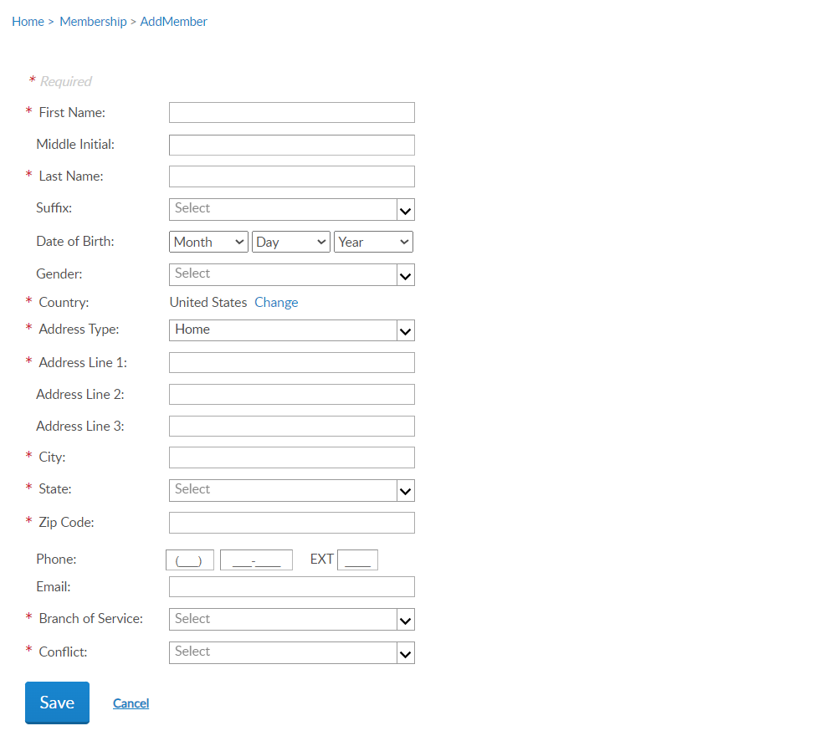
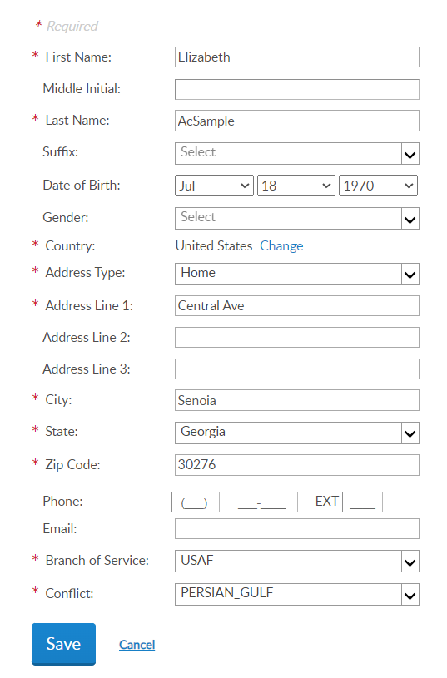
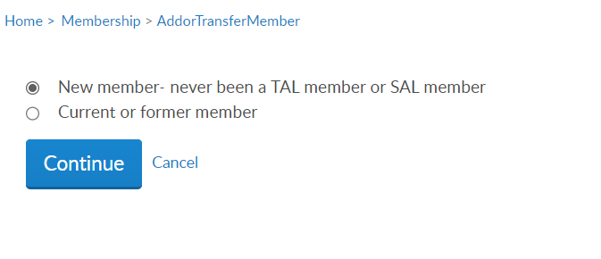
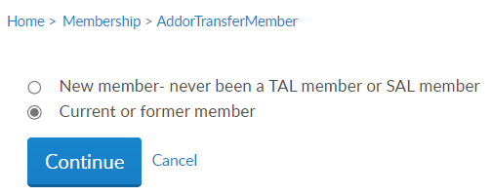
ADD NEW MEMBER
New member – never been a TAL or SAL member
Error Message
“A customer exists with matching details”
A customer exists with matching details 000123456888
Notes:
Select “new member – never been an American Legion or Sons of the American Legion member and click continue. <1>
Enter the member’s information and Save. Fields with an asterisk are required. To enter a foreign address, use the pulldown menu in country, to select country. If you receive the message <2> “A Customer exists with matching details with the member ID#” write down the ID# and click cancel. Go back to add as a new member and treat the member as a current or former member of TAL or SAL.
When adding new members, add as much information as possible. <3> If no matches are found, the member will be added to your batch as a transfer.

Slide 15
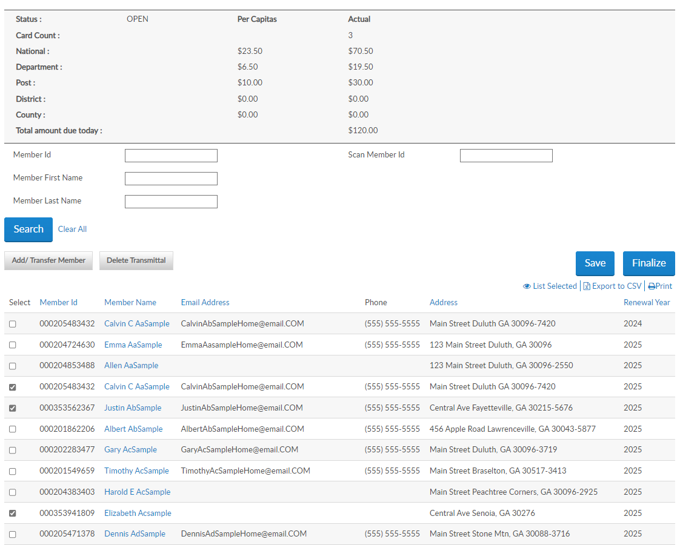
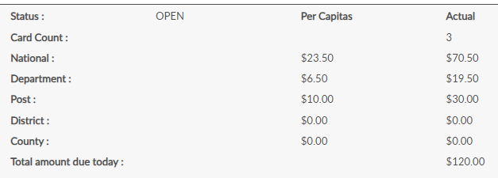
OPEN BATCH
Continue with renew/add/transfer until all members are entered and finalize.
Remove Members
Delete Transmittal
List Selected
000123456783
000123456784
000123456782
000123456783
000123456777
000123456785
000123456787
000123456788
000123456789
000351234567
000123456000
Notes:
The new member is added to the list and the summary updates. Continue renewing, adding and transferring until you are ready to finalize the batch.
You can remove members from an open transmittal. Uncheck the box next to the name and the summary will recalculate. To delete the whole transmittal, select “Delete Transmittal”. <1>
View members in the batch by clicking “List Selected”. <2>

Slide 16
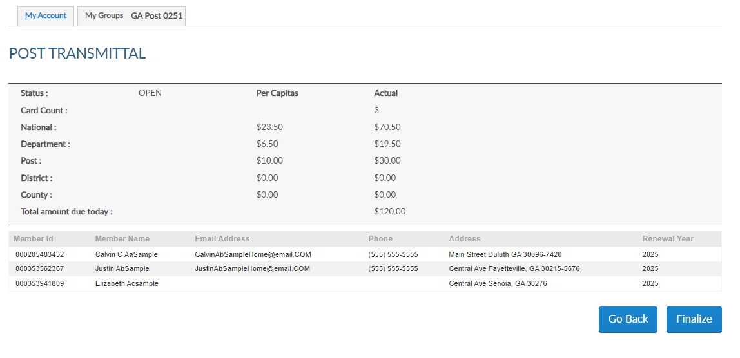
REVIEW TRANSMITTAL
000123456783
000123456777
000351234567
Notes:
The summary allows you to view the total amount due broken down by National, Department, Post, and district and county if necessary. The total amount due is what will be charged to the account on file.
<1> The renewal year displays for review.
<2> You can go back to add/modify the batch or click Finalize to proceed to payment information.

Slide 17
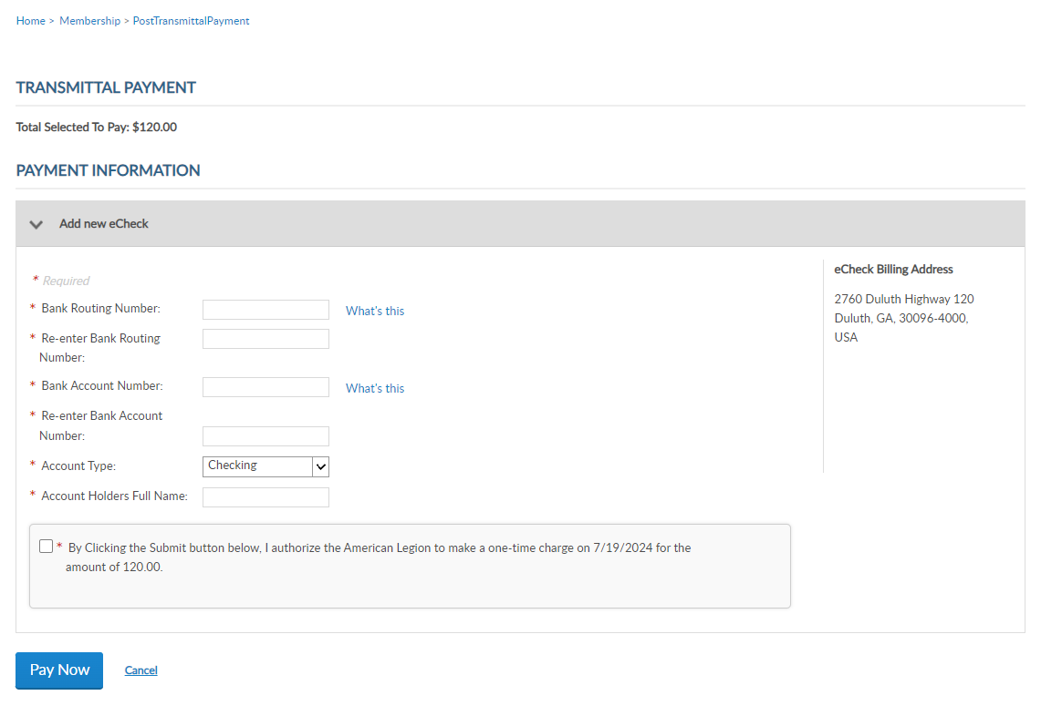
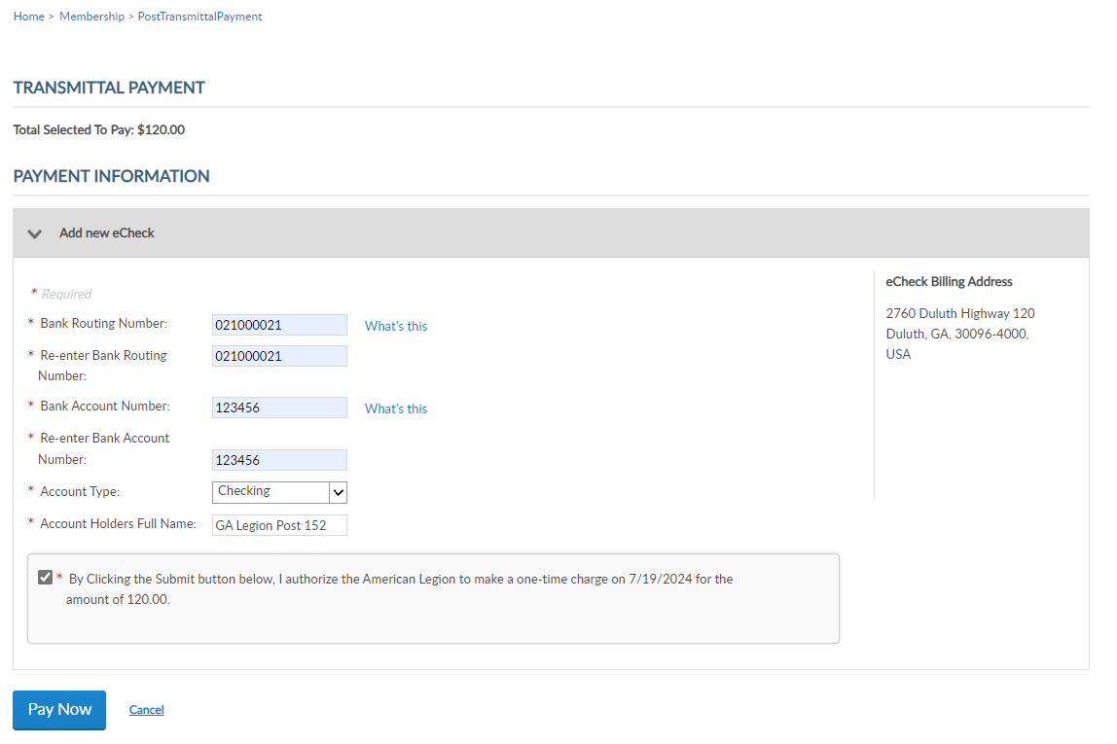
PAYMENT INFORMATION
1st Transmittal
ACH – Domestic
CC – Foreign Depts only
Stores for Future Transmittals
Hold on 1st Transmittal
Authorize / Pay Now
Error? Contact your financial institution.
Notes:
Payment information must be entered when finalizing your first transmittal. Enter the routing and bank account information. The Account Holder’s name is the name of the post or squadron bank account. The billing address is pulled from the post record.
Enter your financial institution’s routing and account number. Routing numbers are 9 digits.
Foreign posts and squadrons will have a credit card option to used with a US credit.
<2> Payment information will be stored for future transmittals. <3> Entering new payment information holds future transmittal from finalizing until the first transmittal completes. This is to ensure all subsequent transmittals have valid bank information.
<4> Enter the bank account information and authorize the one-time charge by clicking the checkbox and Pay Now.
If you receive an error when entering payment information, contact your financial institution to verify ACH payment account information.

Slide 18
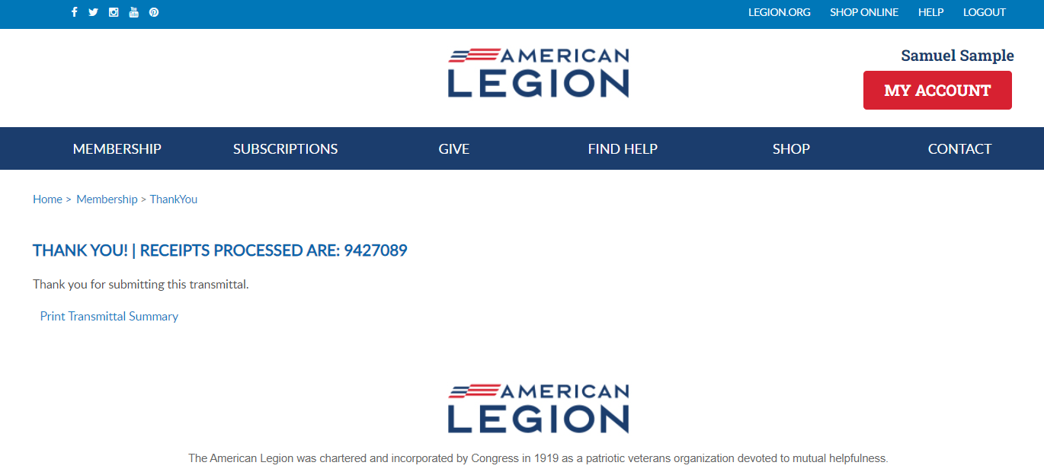
RECEIPT
Receipt Number
Transmittal Summary
Notes:
Finalization of a transmittal produces a receipt number. This is notification the transmittal has been received and is in process.
To view the transmittal summary, and print the receipt, click Print Transmittal Summary.

Slide 19
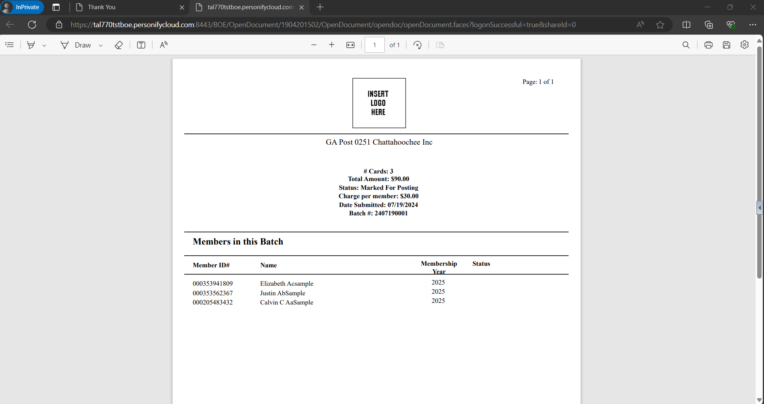
Online Help
Batch Status: Marked for Posting
10 days avg to complete.
Counted in National Target Date report.
Available to Depts for goals report.
Members do not receive renewal notices or renew online.
# Cards: 3
Total Amount: $120.00
Status: Marked For Posting
Charge per member: $40.00
Date Submitted: 07/19/2024
Batch # 2407190001
000351234567
000123456777
000123456783
Notes:
The receipt opens in another tab to print or Save this document for your records. This information is also available in your transmittal history.
The batch status is marked for posting until in completes. <1> Transmittals take an average of 10 days to complete. <2> While in pending status, counts are added to the National Target Date membership reports and are immediately available for Departments to add to their membership reports. <3> Legion members do not receive renewal notices and it prevents them from renewing online that creates duplicate payments.

Slide 20
TRANSMITTAL HISTORY
Notes:
In group profile you can review the transmittal through Transmittal History.

Slide 21
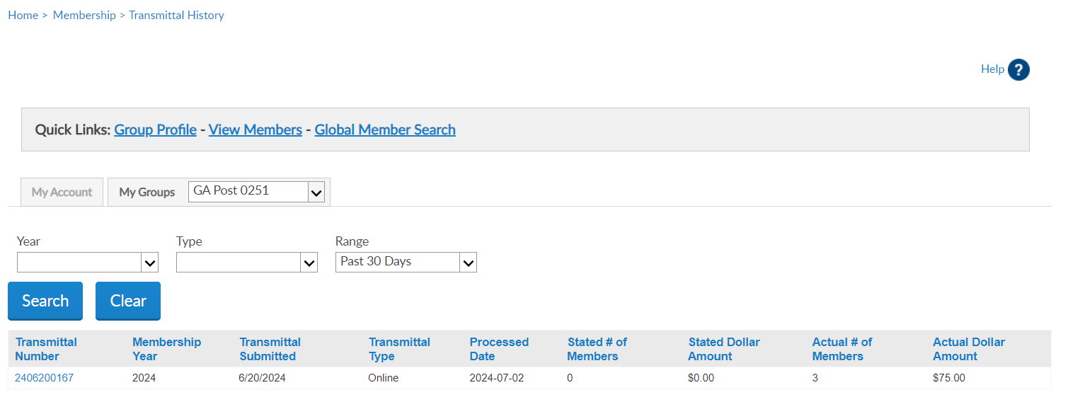
TRANSMITTAL HISTORY
Transmittal Number
Membership Year
Submitted
Type
Processed date
Stated/Actual
Filter: Date Range
History from April 1, 2021 to Present
Click Transmittal Number to View Details
2406180001 2024 6/18/2024 Online 2024-06-30 0 $0.00 3 $90.00
2407019021 Multiple 7/01/2024 Online 2024-07-12 0 $0.00 3 $120.00
2407190001 2024 7/19/2024 Online In Process 0 $0.00 3 $120.00
Notes:
Transmittal history includes reference number, membership year, status, actual number of members submitted and total amount. Stated number and amount only applies to department and detachment transmittals.
Using the Range search field, you can alter the history displayed. Custom range pulls up date fields to set the range of history. Online transmittal history is only available from April 1, 2021 to current.
Clicking on the transmittal number opens details including members in the batch, amount and status.

Slide 22
IMPORTANT INFO
Payment information is entered when finalizing the first transmittal and stored for future batches. A second transmittal cannot be finalized until the first one completes to ensure stored payment information is valid.
Open batches must be finalized within 14 days, or it will be removed, and a new batch will need to be created.
Pending transmittals in process must complete prior to making any adjustments. Renewing a member for the incorrect membership year or any other adjustments are reported to your department.
Transmittals complete in approximately 10 days. Member records are updated when posted. Review transmittal history to view batch status.
$10,000 batch limit.
Notes:
Important information to know about online membership processing.
Payment information is entered when finalizing the first transmittal and stored for future batches. A second transmittal cannot be finalized until the first completes. This hold is to ensure payment information is stored correctly and to prevent multiple declines. Attempting to finalize a transmittal prior to the first one completing will result in an error message. This hold is activated each time new bank information is entered.
<1> Open batches are to be finalized within 14 days. Reminders to submit are emailed to adjutants and are deleted if no action is taken. All members in the transmittal will have to be re-entered in a new batch.
<2> Pending transmittals in process must complete before any adjustments can be made. Renewing a member for the incorrect membership year or any other adjustments are to be reported to your department.
<3> Current processing time is an average of 10 days. Member records are updated when the batch is posted. Review transmittal history to view batch status.
<4> There is a $10,000 batch limit. Amounts higher than that should be broken down to separate transmittals that meet the limit.

Slide 23
IMPORTANT INFO
Stored bank information can be updated when finalizing a transmittal. On the payment window, select “Update Account Information”.
Declined transmittal notifications are sent to adjutants. Declined batches can be resubmitted. Contact myLegion support for questions regarding declined batches.
Available for posts, squadrons, detachments and departments. District and County groups do not have online membership processing.
Notes:
Stored bank information can be updated when finalizing a transmittal. On the payment window, select “Update Account Information”.
<1> Declined batches can be resubmitted. Contact myLegion support for questions regarding declined batches.
<2> Online membership processing is available for posts, squadrons, detachments and departments. Distirct and County groups do not have this feature.

Slide 24
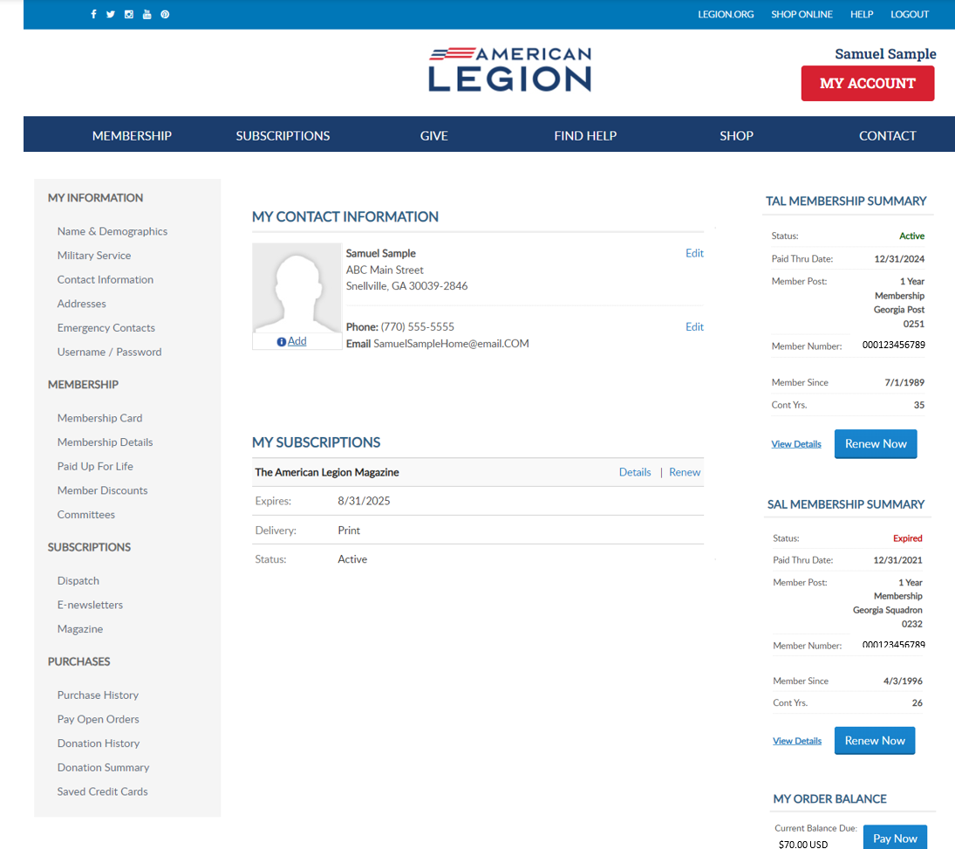
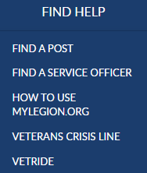
MY ACCOUNT & HELP RESOURCES
Notes:
Learn more about MyLegion using “Find Help”, view the link How to use MyLegion.org.

Slide 25
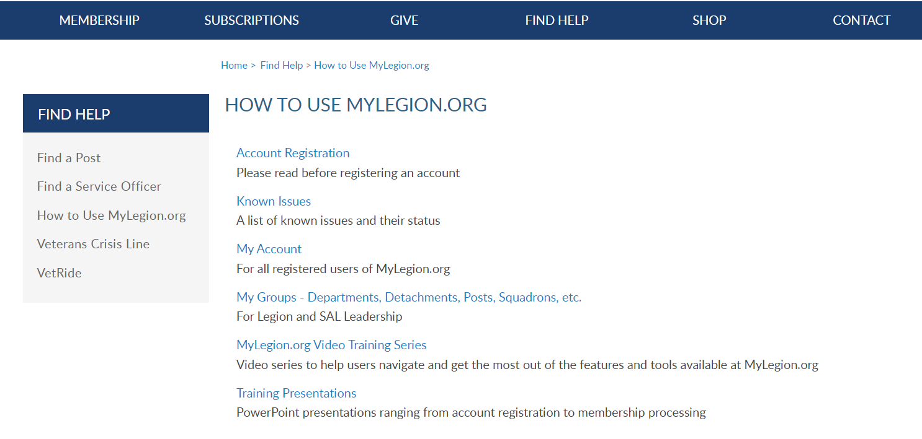
Online Help
Notes:
Step by step instructions, videos and training presentations will assist with how to manage your member account and groups in MyLegion.

Slide 26
Contact your department or national MyLegion support to assist with any questions or help with MyLegion.
MyLegion@legion.org
833.253.9995
Monday – Friday
8:00am – 4:30pm
(Eastern)
Notes:
Contact your department or national MyLegion support to assist with any questions or help with MyLegion.

